Slide 1
Reverse Osmosis Membrane Modelling for Desalination of Sea water using Linear Regression and Simulink
Guided By: Dr. Naresh Thota
Presented by:
P.Lahari Sumanjali(176229)
P.Santhosh(176231)
Randhir Kumar(176137)

Slide 2
MOTIVATION FOR WORK
The demand for fresh water is increasing in many areas around the world. The water shortage problem has been caused by various factors such as inefficiency in water management, the deficiency of water sources, and the salinity of water, which includes underground water and stream water.
Desalination provides a solution for resolving the problem of the water salinity. Amongst all the existing desalination technologies, Reverse Osmosis (RO) is relatively is simple and economically competitive
The development of a proper mathematical model that adequately describes the performance of the RO process is crucial for the optimum design of a RO membrane which can make the RO system more efficient, thereby reducing the overall cost.

Slide 3
OBJECTIVE
To propose model that would be useful to supply portable water in a sustainable and environmentally friendly way
To develop a model that would be used directly for applications so that experimental equipment damage can be prevented.
To study the effect of pressure on the permeate flow and recovery ratio of the RO membrane for a wide range of water conductivities under constant temperature

Slide 4
OUTLINE
In this study, RO systems for seawater desalination were theoretically investigated to provide insight into the optimum process design.
A simple model based on solution-diffusion theory was developed and used to analyze the performance of RO membranes.
A block oriented library for MATLAB/SIMULINK is presented, so that different configurations can be implemented as block diagram to simulate the system and to test control algorithms.
The effect of pressure variation on the permeate flow and recovery ratio of the RO membrane was investigated for a wide range of water conductivities under constant temperature.

Slide 5
INTRODUCTION
RO models
Mechanistic/Membrane Transport models
Irreversible thermodynamic models
Pore models (finely-porous, preferential sorption capillary flow)
Lumped parameter models
Non-porous or homogeneous membrane models (solution-diffusion, solution-diffusion-imperfection, extended solution diffusion)

Slide 6
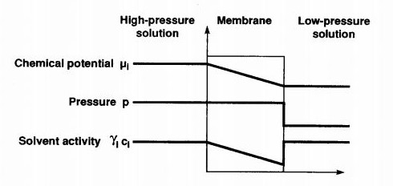
SOLUTION-DIFFUSION MODEL
In solution-diffusion model, the permeants dissolve in the membrane material and then diffuse through the membrane down a concentration gradient.
A separation is achieved between different permeants because of differences in the amount of material that dissolve in the membrane.
The solution-diffusion model assumes that the pressure within a membrane is uniform and that the chemical potential gradient across the membrane is expressed only as concentration gradient.

Slide 7
RO MEMBRANE SPECIFICATIONS
Membrane Specifications
Max Permeate: 1400 l/day
Normal Recovery Ratio: 15%
Max. operating pressure: 41 bar
Operation pressure: 0-25 bar
pH range: 2-11
Salt rejection: 99%
Max. Operating temperature: 45 C
Membrane: Spiral wound-Thin film polyamide membrane
The membrane cylinder contains one membrane with a diameter of 2.5 inches, which is used to desalinate salt water up to 10,000 ppm

Slide 8
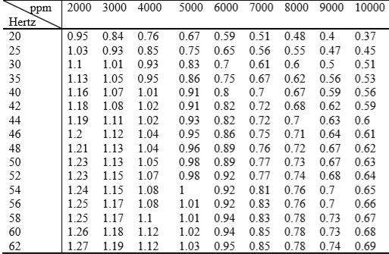
EXPERIMENTAL DATA (TAKEN FROM LITEARATURE)
The feed stream characteristics changed in the tests were pressure, flow and conductivity. And the feed temperature was not taken into consideration during the tests due to steady feature of the temperature over long data
Table: Flowrate of product water vs motor frequency and feed water conductivity

Slide 9
MATHEMATICAL MODELLING
Permeate Mass and Salt Balance:
M_{f} = M_{b} + M_{p}
M_{f} X_{f}= M_{b} X_{b}+ M_{p} X_{p}
Where M_{f} is the feed stream flow rate, kg /s ;
M_{p} is the permeate flow rate, kg /s;
M_{b} is the brine flow rate, kg /s ;
X_{f} is the feed salinity, kg/m³ ;
X_{p} is the permeate salinity, kg/m³;
X_{b} is the brine salinity, kg/m³.
Water transport:
Rate of water passage through a semipermeable membrane is given by M_{p} =(∆p−∆π) * K_{w}*A
Where ∆p is the hydraulic pressure differential across the membrane, kPa;
∆π is the osmotic pressure differential across the membrane, kPa;
K_{w} is the water permeability coefficient;
A is the membrane area, m² ;

Slide 10
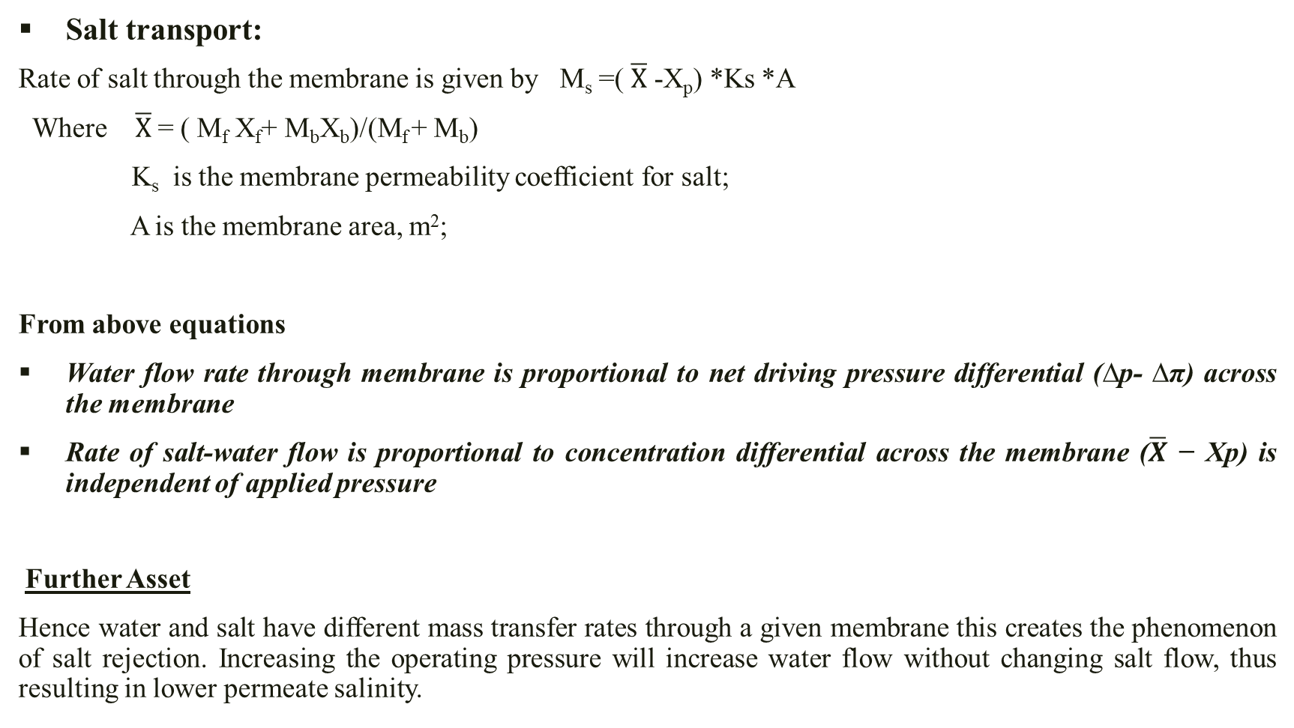
Salt transport:
Rate of salt through the membrane is given by M_{s} =( $\overline{X}$ -X_{p}) *Ks *A
Where $\overline{X}$ = ( M_{f} X_{f}+ M_{b}X_{b})/(M_{f} + M_{b})
K_{s} is the membrane permeability coefficient for salt;
A is the membrane area, m²;
From above equations
Water flow rate through membrane is proportional to net driving pressure differential (∆p- ∆π) across the membrane
Rate of salt-water flow is proportional to concentration differential across the membrane ($\overline{X}$ − Xp) is independent of applied pressure
Further Asset
Hence water and salt have different mass transfer rates through a given membrane this creates the phenomenon of salt rejection. Increasing the operating pressure will increase water flow without changing salt flow, thus resulting in lower permeate salinity.

Slide 11
Recovery Ratio
Recovery ratio of RO system is defined as the ratio of permeate flow rate to feed flow rate
Rec = Q_{p} /Q_{f}
Where Q_{f} is the flow rate at inlet of membrane, liter/min
Q_{p} is the permeate flow rate, liter/min
For the same membrane characteristics, Q_{f} can be determined from matlab model of pump
Q_{f} = 0.012*N_{m} – 4.3
Where N_{m} is the rotational speed of motor, rpm

Slide 12
MODELLING PROCEDURE
For determining complex polynomial relationships between two variables, we use polyfit function in MATLAB
Since many of the components in the system have variables that depend on more than one variable, “Linear-in-the parameters Multiple Regression”, is used.
It consists of a data regression routine, which fitted the data points to a predefined non-linear relationship, through least-squares error minimization.
To calculate the relationship between an output variable, Y₁ and two input variables, X_{1,}X₂, the following non-linear model (linear-in-the-parameters) can be defined:
Y=f (X_{1,}X₂) = k₁+k ₂ X₁^{n} X₂ ^{n} + k ₃X₁^{n-1} X₂ ^{n-1} +………………..+ k _{n-1}X₁ X₂
Where Y₁ is the dependent variable;
X₁ and X₂ are the independent variables.

Slide 13
LINEAR-IN-THE-PARAMETERS MULTIPLE REGRESSION
Consider equation as Y=f (X_{1,}X₂) = k ₁X₁³ + k ₂X₁²+k₃ X₁+ k ₄ X₂ +k₅
By using gradient descent technique, iterating gradient descent of coefficients until cost function reaches its global minimum value. Cost function is the sum of squared errors between experimental values and the values obtained by assumed hypothesis.
Gradient Descent for Multiple Variables: The gradient descent equation itself is generally the same form; we just have to repeat it for our 'n' features: repeat until convergence:
{
k0:=k0−α*1/m*(∑i=1m(hθ(x(i))−y(i))⋅x(i)0)
k1:=k1−α*1/m*(∑i=1m(hθ(x(i))−y(i))⋅x(i)1)
k2:=k2−α*1/m*(∑i=1m(hθ(x(i))−y(i))⋅x(i)2)
k3:=k3−α*1/m*(∑i=1m(hθ(x(i))−y(i))⋅x(i)3)
k4:=k4−α*1/m*(∑i=1m(hθ(x(i))−y(i))⋅x(i)4)
}
Learning rate α gives the rate of speed where the gradient moves during gradient descent. Setting it too high would make path instable, too low would make convergence slow. So learning rate should be taken by observing the stability of the model. In this model we have taken learning as 2.000000000000000e-11 and total number of iterations that are allowed as 1000000..

Slide 14
CODE
function J = computeCostMulti(X, y, theta)
%COMPUTECOSTMULTI Compute cost for linear regression with multiple variables
% J = COMPUTECOSTMULTI(X, y, theta) computes the cost of using theta as the parameter for linear regression to fit the data points in X and y
% Initialize some useful values
m = length(y); % number of training examples
J=0;
% You need to return the following variables correctly
J = (1/(2*m)) * (X * theta - y)' * (X * theta - y);
End

Slide 15
X =[20;25;30;35;40;42;44;46;48;50;52;54;56;58;60];
y =[0.37 0.45 0.51 0.53 0.56 0.59 0.6 0.61 0.62 0.63 0.64 0.65 0.66 0.67 0.68];
y=y’;
m=length(y);
X=[X.*X.*X X.*X X 10000*ones(m,1) ones(m,1)];
alpha = 0.00000000002;
num_iters = 1000000;
J_history = zeros(num_iters, 1);
theta = zeros(5, 1);
for iter = 1:num_iters
theta = theta - alpha * (1/m) * (((X*theta) - y)' * X)’;
J_history(iter) = computeCostMulti(X, y, theta); Table:Evaluated constants using Linear Regresion
end
Conductivity(ppm) | K₁ | K₂ | K₃ | K₄ | K₅
2000 | -1.5084*10⁻⁶ | 0.000178 | 7.5348*10⁻⁶ | 0.000478 | 2.3937*10⁻⁷
3000 | -6.2457*10⁻⁷ | 1.2502*10⁻⁴ | 4.4752*10⁻⁶ | 2.9713*10⁻⁴ | 9.9044*10⁻⁸
4000 | -2.5791*10⁻⁷ | 0.000105 | 3.4033*10⁻⁶ | 0.0002041 | 5.1034*10⁻⁸
5000 | 8.6083*10⁻⁹ | 9.5762*10⁻⁵ | 2.8276*10⁻⁶ | 0.0001429 | 2.8583*10⁻⁸
6000 | 2.2215*10⁻⁷ | 8.8810*10⁻⁵ | 2.4855*10⁻⁶ | 0.0001034 | 1.1723*10⁻⁸
7000 | 4.3029*10⁻⁷ | 6.7406*10⁻⁵ | 1.9038*10⁻⁶ | 7.7173*10⁻⁵ | 1.1024*10⁻⁸
8000 | 1.8758*10⁻⁷ | 6.9593*10⁻⁵ | 1.9229*10⁻⁶ | 6.5229*10⁻⁵ | 8.1537*10⁻⁹
9000 | 3.0643*10⁻⁷ | 7.2486*10⁻⁵ | 1.9531*10⁻⁶ | 4.8630*10⁻⁵ | 5.4034*10⁻⁹
10000 | 1.1877*10⁻⁷ | 7.2213*10⁻⁵ | 1.9628*10⁻⁶ | 4.2277*10⁻⁵ | 4.2277*10⁻⁹

Slide 16
For the error’s rate the fitting shall be kept minimal, the mean values of k1, k2, k3, k4 were selected and listed as below.
And the final equation for the membrane productivity with respect to the motor frequency and feed water conductivity is presented that consists of two input variables in form of 3rd order polynomial and is given as:
Y_{p} = -0.000000124X₁³+ 0.0000971 X₁²+ 0.00000316 X₁ + 0.000162X₂ + 0.0000000491
Where X₁ is motor frequency, Hz;
X₂ is feed water conductivity, ppm;
Y_{p} is permeate flow rate; liter/min;
We can also use expressions such as
Y=f (X_{1,}X₂) = k₁+k ₂ X₁ + k ₃X₁ X₂ + k₄ X₁²
Y=f (X_{1,}X₂) = k₁+k ₂ X₁² + k ₃X₁²X₂ +k₄ X1 X₂+ k₅ X₁³........
And the one that fits the data with minimum error can be used as the suitable model
Coefficients | Mean value of coefficients
K₁ | -1.2497*10⁻⁷
K₂ | 9.714*10⁻⁵
K₃ | 3.161*10⁻⁶
K₄ | 1.62*10⁻⁴
K₅ | 4.91*10⁻⁸

Slide 17
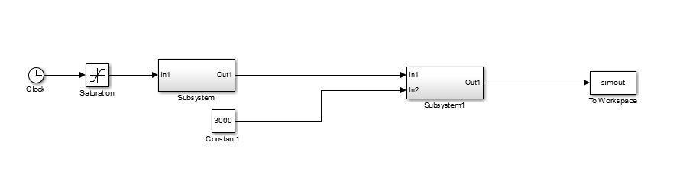
SIMULATION OF MEMBRANE PERFORMANCE
Using the generated equation, the functions blocks were created to represent the equation. .A clock function in source category was chosen to give a constant rising input values from 0-16. These values, then, were used to be as motor frequency that is input into the RO system.
Simulink model of the RO membrane
In reality, the variation of motor frequency spans from 20 to 65 Hertz. Thus, the inverter output frequency needs scaling utilizing the equation given by: U=0.36×F - 6.11
Here U is scaled frequency, Hz;
F is motor frequency, Hz

Slide 18
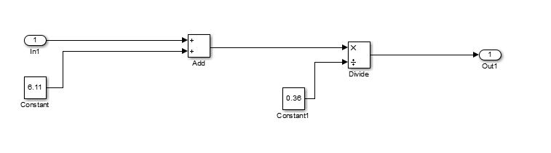
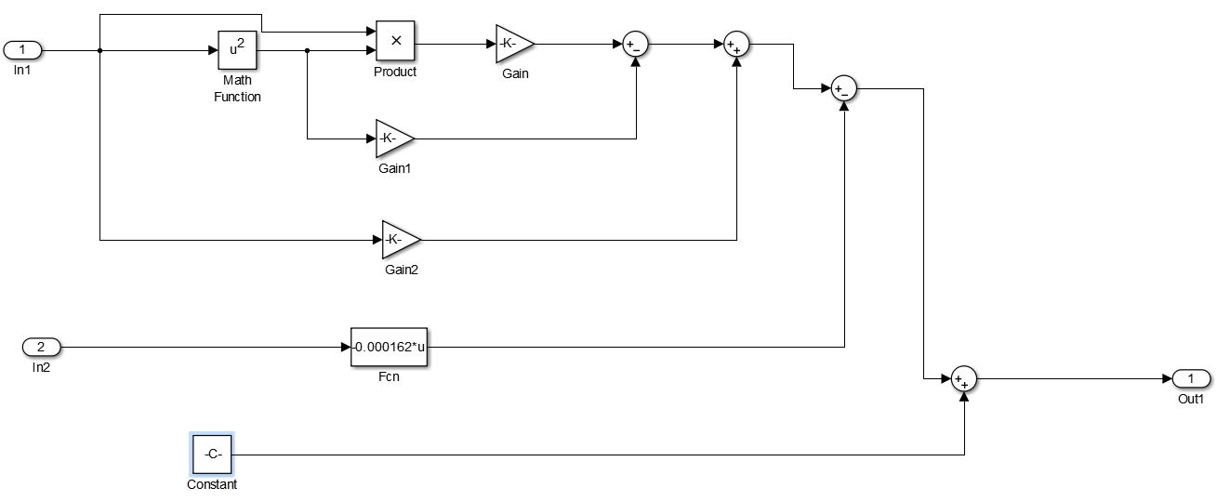
Subsystem in Simulink model
Subsystem1 in Simulink model

Slide 19
SIMULATION RESULTS
Variation of permeate flux( lt/min) with water conductivities and motor frequency
Scaled frequency | 2000 ppm | 3000 ppm | 4000 ppm | 5000 ppm | 6000 ppm | 7000 ppm | 8000 ppm | 9000 ppm | 10000 ppm
0 | 1.001763689 | 0.924440074 | 0.845612445 | 0.742260186 | 0.647184949 | 0.561767705 | 0.542834603 | 0.46008987 | 0.444186754
3.15544E-30 | 1.001763689 | 0.924440074 | 0.845612445 | 0.742260186 | 0.647184949 | 0.561767705 | 0.542834603 | 0.46008987 | 0.444186754
0.32 | 1.006088845 | 0.927809974 | 0.848660452 | 0.745234759 | 0.65011673 | 0.564204648 | 0.545142911 | 0.462583935 | 0.446520542
0.64 | 1.010568959 | 0.931324565 | 0.851852676 | 0.74836139 | 0.653207664 | 0.566784545 | 0.547577077 | 0.465218494 | 0.448978502
0.96 | 1.015197675 | 0.934981214 | 0.85518803 | 0.751640114 | 0.656458688 | 0.56950921 | 0.550137893 | 0.467994839 | 0.451561136
1.28 | 1.019968636 | 0.938777289 | 0.858665427 | 0.755070968 | 0.659870737 | 0.572380455 | 0.552826149 | 0.470914261 | 0.454268943
1.6 | 1.024875485 | 0.942710158 | 0.86228378 | 0.758653989 | 0.663444749 | 0.575400095 | 0.555642635 | 0.473978051 | 0.457102424
1.92 | 1.029911866 | 0.94677719 | 0.866042003 | 0.762389213 | 0.667181658 | 0.578569941 | 0.558588142 | 0.4771875 | 0.46006208
2.24 | 1.035071422 | 0.950975752 | 0.869939009 | 0.766276675 | 0.671082401 | 0.581891808 | 0.56166346 | 0.4805439 | 0.463148411
2.56 | 1.040347797 | 0.955303213 | 0.87397371 | 0.770316412 | 0.675147915 | 0.585367509 | 0.56486938 | 0.484048542 | 0.466361917
2.88 | 1.045734632 | 0.95975694 | 0.87814502 | 0.774508461 | 0.679379135 | 0.588998856 | 0.568206692 | 0.487702718 | 0.4697031
3.2 | 1.051225572 | 0.964334301 | 0.882451852 | 0.778852858 | 0.683776997 | 0.592787664 | 0.571676186 | 0.491507719 | 0.47317246
3.52 | 1.05681426 | 0.969032665 | 0.886893119 | 0.783349638 | 0.688342439 | 0.596735745 | 0.575278654 | 0.495464835 | 0.476770496
3.84 | 1.062494339 | 0.973849399 | 0.891467734 | 0.787998839 | 0.693076395 | 0.600844913 | 0.579014885 | 0.49957536 | 0.480497711
4.16 | 1.068259453 | 0.978781872 | 0.896174611 | 0.792800497 | 0.697979803 | 0.605116981 | 0.582885671 | 0.503840582 | 0.484354604
4.48 | 1.074103244 | 0.983827452 | 0.901012662 | 0.797754647 | 0.703053598 | 0.609553762 | 0.5868918 | 0.508261796 | 0.488341676
4.8 | 1.080019356 | 0.988983507 | 0.905980801 | 0.802861326 | 0.708298716 | 0.614157069 | 0.591034065 | 0.51284029 | 0.492459427
5.12 | 1.086001433 | 0.994247404 | 0.911077941 | 0.808120571 | 0.713716094 | 0.618928716 | 0.595313255 | 0.517577358 | 0.496708357
5.44 | 1.092043116 | 0.999616512 | 0.916302995 | 0.813532417 | 0.719306668 | 0.623870516 | 0.599730162 | 0.522474289 | 0.501088969
5.76 | 1.098138051 | 1.005088198 | 0.921654876 | 0.819096901 | 0.725071373 | 0.628984283 | 0.604285574 | 0.527532376 | 0.505601761
6.08 | 1.104279879 | 1.010659832 | 0.927132498 | 0.82481406 | 0.731011147 | 0.634271829 | 0.608980284 | 0.53275291 | 0.510247235
6.4 | 1.110462244 | 1.01632878 | 0.932734772 | 0.830683929 | 0.737126926 | 0.639734967 | 0.613815081 | 0.538137182 | 0.51502589
6.72 | 1.11667879 | 1.022092412 | 0.938460614 | 0.836706544 | 0.743419644 | 0.645375512 | 0.618790756 | 0.543686483 | 0.519938228
7.04 | 1.122923159 | 1.027948094 | 0.944308935 | 0.842881943 | 0.74989024 | 0.651195276 | 0.623908099 | 0.549402105 | 0.524984749
7.36 | 1.129188996 | 1.033893195 | 0.950278649 | 0.849210161 | 0.756539648 | 0.657196072 | 0.629167901 | 0.55528534 | 0.530165954
7.68 | 1.135469942 | 1.039925083 | 0.956368668 | 0.855691234 | 0.763368806 | 0.663379715 | 0.634570952 | 0.561337478 | 0.535482343
8 | 1.141759642 | 1.046041127 | 0.962577907 | 0.862325199 | 0.770378648 | 0.669748016 | 0.640118042 | 0.56755981 | 0.540934416

Slide 20
8.32 | 1.148051738 | 1.052238693 | 0.968905279 | 0.869112093 | 0.777570112 | 0.676302789 | 0.645809964 | 0.573953629 | 0.546522675
8.64 | 1.154339875 | 1.058515151 | 0.975349695 | 0.876051951 | 0.78944133 | 0.683045849 | 0.651647505 | 0.580520225 | 0.552247619
8.96 | 1.160617694 | 1.064867868 | 0.98191007 | 0.883144809 | 0.792501648 | 0.689979006 | 0.657631458 | 0.58726089 | 0.558109749
9.28 | 1.16687884 | 1.071294212 | 0.988585317 | 0.890390705 | 0.800243593 | 0.697104076 | 0.663762613 | 0.594176915 | 0.564109566
9.6 | 1.173116956 | 1.077791552 | 0.995374349 | 0.897789673 | 0.808170904 | 0.704422872 | 0.670041759 | 0.601269592 | 0.57024757
9.92 | 1.179325684 | 1.084357254 | 1.002276079 | 0.905341751 | 0.816284518 | 0.711937205 | 0.676469688 | 0.608540211 | 0.576524262
10.24 | 1.185498669 | 1.090988688 | 1.00928942 | 0.913046975 | 0.824585369 | 0.719648891 | 0.68304719 | 0.615990064 | 0.582940143
10.56 | 1.191629553 | 1.097683222 | 1.016413285 | 0.920905381 | 0.833074395 | 0.727559742 | 0.689775056 | 0.623620443 | 0.589495712
10.88 | 1.19771198 | 1.104438223 | 1.023646587 | 0.928917006 | 0.841752532 | 0.735671571 | 0.696654076 | 0.631432639 | 0.59619147
11.2 | 1.203739593 | 1.111251059 | 1.030988241 | 0.937081884 | 0.850620716 | 0.743986191 | 0.70368504 | 0.639427943 | 0.603027918
11.52 | 1.209706034 | 1.118119099 | 1.038437157 | 0.945400054 | 0.859679883 | 0.752505417 | 0.710868739 | 0.647607646 | 0.610005557
11.84 | 1.215604949 | 1.125039711 | 1.045992251 | 0.953871551 | 0.868930969 | 0.76123106 | 0.718205963 | 0.65597304 | 0.617124886
12.16 | 1.221429979 | 1.132010262 | 1.053652435 | 0.962496411 | 0.87837491 | 0.770164935 | 0.725697504 | 0.664525416 | 0.624386407
12.48 | 1.227174767 | 1.139028121 | 1.061416621 | 0.971274671 | 0.888012643 | 0.779308855 | 0.73334415 | 0.673266066 | 0.63179062
12.8 | 1.232832958 | 1.146090655 | 1.069283724 | 0.980206367 | 0.897845104 | 0.788664632 | 0.741146694 | 0.68219628 | 0.639338025
13.12 | 1.238398195 | 1.153195233 | 1.077252657 | 0.989291536 | 0.907873229 | 0.79823408 | 0.749105925 | 0.691317351 | 0.647029124
13.44 | 1.24386412 | 1.160339223 | 1.085322332 | 0.998530212 | 0.918097954 | 0.808019013 | 0.757222633 | 0.700630569 | 0.654864415
13.76 | 1.249224377 | 1.167519993 | 1.093491663 | 1.007922434 | 0.928520215 | 0.818021244 | 0.76549761 | 0.710137225 | 0.662844401
14.08 | 1.254472609 | 1.17473491 | 1.101759562 | 1.017468237 | 0.939140948 | 0.828242585 | 0.773931646 | 0.719838612 | 0.670969582
14.4 | 1.25960246 | 1.181981344 | 1.110124944 | 1.027167657 | 0.94996109 | 0.838684851 | 0.78252553 | 0.72973602 | 0.679240457
14.72 | 1.264607572 | 1.189256661 | 1.11858672 | 1.03702073 | 0.960981577 | 0.849349854 | 0.791280055 | 0.739830741 | 0.687657528
15.04 | 1.269481589 | 1.196558231 | 1.127143805 | 1.047027494 | 0.972203345 | 0.860239407 | 0.800196009 | 0.750124066 | 0.696221296
15.36 | 1.274218155 | 1.20388342 | 1.135795111 | 1.057187983 | 0.98362733 | 0.871355325 | 0.809274184 | 0.760617287 | 0.70493226
15.68 | 1.278810911 | 1.211229597 | 1.144539552 | 1.067502235 | 0.995254468 | 0.88269942 | 0.81851537 | 0.771311694 | 0.713790921
16 | 1.283253503 | 1.218594131 | 1.153376041 | 1.077970286 | 1.007085695 | 0.894273505 | 0.827920358 | 0.78220858 | 0.72279778

Slide 21
Recovery ratios for various feed water conductivities and flow rates
Motor speed | Feed flow rate(lit/min) | R(2000 ppm) | R(3000 ppm) | R(4000 ppm) | R(5000 ppm) | R(6000 ppm) | R(7000 ppm) | R(8000 ppm) | R(9000 ppm) | R(10000 ppm)
509.15241 | 1.80982892 | 0.553512919 | 0.510788652 | 0.467233358 | 0.410127265 | 0.35759455 | 0.310398236 | 0.29993697 | 0.25421733 | 0.245430244
535.81833 | 2.12981996 | 0.472382109 | 0.435628359 | 0.398465818 | 0.34990505 | 0.30524492 | 0.264907203 | 0.25595727 | 0.21719392 | 0.209651778
562.48425 | 2.449811 | 0.412508948 | 0.380161802 | 0.347721794 | 0.305477194 | 0.26663594 | 0.231358478 | 0.22351809 | 0.18989975 | 0.18327067
589.15017 | 2.76980204 | 0.366523549 | 0.337562468 | 0.308754206 | 0.271369615 | 0.23700563 | 0.205613687 | 0.19861993 | 0.16896328 | 0.163030112
615.81609 | 3.08979308 | 0.330109043 | 0.303831766 | 0.277903861 | 0.244375901 | 0.2135647 | 0.185248798 | 0.17892012 | 0.15240964 | 0.147022448
642.48201 | 3.40978412 | 0.300569024 | 0.276472095 | 0.252885153 | 0.222493261 | 0.1945709 | 0.168749714 | 0.16295537 | 0.1390053 | 0.134056118
669.14793 | 3.72977516 | 0.276132427 | 0.253842966 | 0.232196839 | 0.204406212 | 0.17887986 | 0.155121935 | 0.14976456 | 0.12794002 | 0.123348475
695.81385 | 4.0497662 | 0.255587945 | 0.234822384 | 0.214812156 | 0.18921504 | 0.16570892 | 0.143685284 | 0.13869034 | 0.11865967 | 0.114364234
722.47977 | 4.36975724 | 0.238079083 | 0.218616999 | 0.200005095 | 0.176283571 | 0.15450467 | 0.133958817 | 0.12926791 | 0.11077241 | 0.106724903
749.14569 | 4.68974828 | 0.222983105 | 0.20464999 | 0.187247794 | 0.165149261 | 0.14486473 | 0.125592851 | 0.12115932 | 0.10399337 | 0.10015529
775.81161 | 5.00973932 | 0.209836382 | 0.192491912 | 0.176147259 | 0.155467742 | 0.13648954 | 0.118327048 | 0.11411296 | 0.09811044 | 0.094450515
802.47753 | 5.32973036 | 0.198286628 | 0.181816452 | 0.166404876 | 0.146977349 | 0.12915146 | 0.11196359 | 0.10793767 | 0.09296246 | 0.0894549
829.14345 | 5.6497214 | 0.188061369 | 0.172371225 | 0.15778968 | 0.139475699 | 0.12267444 | 0.106349476 | 0.10248556 | 0.08842478 | 0.085048036
855.80937 | 5.96971244 | 0.178946551 | 0.16395796 | 0.150120231 | 0.1328038 | 0.11692017 | 0.101364511 | 0.09764049 | 0.08439947 | 0.081135333
882.47529 | 6.28970348 | 0.170771682 | 0.156418733 | 0.143252009 | 0.126835017 | 0.1117785 | 0.096912957 | 0.09330993 | 0.08080855 | 0.077641446
909.14121 | 6.60969452 | 0.163399285 | 0.149626205 | 0.137068483 | 0.121467236 | 0.10716058 | 0.092917618 | 0.08941927 | 0.07758911 | 0.074505626
935.80713 | 6.92968556 | 0.156717274 | 0.143476554 | 0.131474644 | 0.116617206 | 0.10299401 | 0.089315556 | 0.08590769 | 0.07468988 | 0.07167834
962.47305 | 7.2496766 | 0.150633356 | 0.13788429 | 0.126392258 | 0.112216373 | 0.09921914 | 0.086054944 | 0.08272509 | 0.07206863 | 0.069118803
989.13897 | 7.56966764 | 0.145070841 | 0.132778379 | 0.12175632 | 0.108207776 | 0.09578642 | 0.083092721 | 0.07982987 | 0.0696903 | 0.066793126
1015.80489 | 7.88965868 | 0.139965482 | 0.12809931 | 0.117512371 | 0.104543694 | 0.09265434 | 0.08039281 | 0.07718715 | 0.06752547 | 0.064672916
1042.47081 | 8.20964972 | 0.135263048 | 0.123796851 | 0.113614442 | 0.101183845 | 0.08978787 | 0.077924758 | 0.07476751 | 0.06554935 | 0.06273421

Slide 22
1069.13673 | 8.52964076 | 0.130917447 | 0.119828307 | 0.110023463 | 0.098093996 | 0.08715721 | 0.075662684 | 0.07254593 | 0.06374084 | 0.060956638
1095.80265 | 8.8496318 | 0.126889252 | 0.11615716 | 0.106706014 | 0.09524486 | 0.08473689 | 0.073584449 | 0.07050102 | 0.06208192 | 0.059322779
1122.46857 | 9.16962284 | 0.123144541 | 0.112751987 | 0.103633341 | 0.092611242 | 0.08250499 | 0.071671004 | 0.06861437 | 0.06055705 | 0.05781764
1149.13449 | 9.48961388 | 0.119653967 | 0.109585606 | 0.100780567 | 0.090171344 | 0.08044256 | 0.06990587 | 0.06687005 | 0.05915283 | 0.056428254
1175.80041 | 9.80960492 | 0.116392011 | 0.106634379 | 0.098126063 | 0.087906211 | 0.0785331 | 0.068274719 | 0.06525421 | 0.05785756 | 0.055143344
1202.46633 | 10.12959596 | 0.11333638 | 0.103877657 | 0.09565093 | 0.085799285 | 0.0767622 | 0.066765031 | 0.06375476 | 0.05666106 | 0.053953058
1229.13225 | 10.449587 | 0.110467512 | 0.101297319 | 0.093338588 | 0.083836036 | 0.07511724 | 0.065365822 | 0.06236108 | 0.05555437 | 0.052848751
1255.79817 | 10.76957804 | 0.107768168 | 0.098877399 | 0.091174424 | 0.082003659 | 0.07358707 | 0.064067413 | 0.06106381 | 0.05452961 | 0.051822806
1282.46409 | 11.08956908 | 0.1052231 | 0.096603773 | 0.089145512 | 0.08029083 | 0.07216183 | 0.062861241 | 0.05985468 | 0.0535798 | 0.050868484
1309.13001 | 11.40956012 | 0.102818772 | 0.0944639 | 0.087240379 | 0.078687492 | 0.07083278 | 0.061739705 | 0.05872635 | 0.05269875 | 0.049979803
1335.79593 | 11.72955116 | 0.100543121 | 0.092446611 | 0.085448801 | 0.077184688 | 0.06959214 | 0.060696031 | 0.05767226 | 0.05188095 | 0.049151434
1362.46185 | 12.0495422 | 0.09838537 | 0.09054192 | 0.08376164 | 0.075774412 | 0.06843292 | 0.059724169 | 0.05668657 | 0.05112145 | 0.048378613
1389.12777 | 12.36953324 | 0.096335854 | 0.088740877 | 0.082170706 | 0.074449485 | 0.0673489 | 0.05881869 | 0.05576403 | 0.05041584 | 0.04765707
1415.79369 | 12.68952428 | 0.094385885 | 0.087035432 | 0.080668634 | 0.073203454 | 0.06633444 | 0.057974716 | 0.05489994 | 0.04976015 | 0.046982965
1442.45961 | 13.00951532 | 0.092527628 | 0.085418329 | 0.079248782 | 0.072030499 | 0.06538451 | 0.057187849 | 0.05409003 | 0.04915079 | 0.046352835
1469.12553 | 13.32950636 | 0.090754001 | 0.083883009 | 0.077905147 | 0.070925361 | 0.0644945 | 0.05645411 | 0.05333046 | 0.04858452 | 0.045763552
1495.79145 | 13.6494974 | 0.089058587 | 0.082423527 | 0.076632291 | 0.069883273 | 0.06366029 | 0.055769897 | 0.05261776 | 0.0480584 | 0.045212279
1522.45737 | 13.96948844 | 0.087435555 | 0.081034482 | 0.07542527 | 0.068899904 | 0.0628781 | 0.055131935 | 0.05194875 | 0.04756978 | 0.04469644
1549.12329 | 14.28947948 | 0.085879599 | 0.07971096 | 0.074279586 | 0.067971312 | 0.06214451 | 0.054537246 | 0.05132056 | 0.04711621 | 0.04421369
1575.78921 | 14.60947052 | 0.084385875 | 0.078448473 | 0.073191135 | 0.067093901 | 0.06145638 | 0.053983108 | 0.05073057 | 0.04669548 | 0.043761889
1602.45513 | 14.92946156 | 0.082949957 | 0.077242922 | 0.072156163 | 0.066264381 | 0.06081085 | 0.053467037 | 0.05017635 | 0.04630558 | 0.04333908
1629.12105 | 15.2494526 | 0.081567788 | 0.076090549 | 0.071171232 | 0.065479741 | 0.06020531 | 0.052986755 | 0.04965573 | 0.04594464 | 0.04294347
1655.78697 | 15.56944364 | 0.080235647 | 0.074987907 | 0.070233188 | 0.064737216 | 0.05963734 | 0.052540172 | 0.04916666 | 0.04561096 | 0.042573416
1682.45289 | 15.88943468 | 0.07895011 | 0.073931825 | 0.069339129 | 0.064034263 | 0.05910474 | 0.052125365 | 0.04870731 | 0.04530297 | 0.042227404
1709.11881 | 16.20942572 | 0.077708025 | 0.072919384 | 0.068486383 | 0.063368541 | 0.05860548 | 0.051740565 | 0.04827596 | 0.04501924 | 0.041904042
1735.78473 | 16.52941676 | 0.076506485 | 0.07194789 | 0.067672486 | 0.06273789 | 0.05813766 | 0.051384139 | 0.04787102 | 0.04475843 | 0.041602044
1762.45065 | 16.8494078 | 0.075342802 | 0.071014854 | 0.066895158 | 0.062140314 | 0.05769956 | 0.051054578 | 0.04749105 | 0.04451931 | 0.041320223
1789.11657 | 17.16939884 | 0.074214489 | 0.070117972 | 0.066152294 | 0.061573966 | 0.05728956 | 0.050750485 | 0.04713468 | 0.04430075 | 0.041057481
1815.78249 | 17.48938988 | 0.073119241 | 0.069255109 | 0.065441937 | 0.061037134 | 0.05690619 | 0.050470567 | 0.04680068 | 0.04410169 | 0.040812797
1842.881 | 17.80938092 | 0.072054919 | 0.068424284 | 0.064762276 | 0.060528229 | 0.05654805 | 0.050213621 | 0.04648788 | 0.04392116 | 0.040585228

Slide 23
GRAPHICAL REPRESENTATION
Inlet flow rate of product tank vs motor frequency

Slide 24
Inlet flow rate of product tank vs motor frequency

Slide 25
CONCLUSIONS
In this work, RO membrane for seawater desalination was theoretically investigated using a simple model based on solution-diffusion theory. The following conclusions can be drawn from this work
Simulation results show that the model behaves qualitatively similar to a real plant
Moreover, parameter estimation has to be carried out in order to adjust model to real plant
RO membrane performance can be checked using models to avoid damage of membrane
Recovery ratio plays an important role in the selection of membrane
In the proposed model, the bulk feed velocity plays the important role for improvement of permeate flux
Higher flux improves the salt rejection, but increases the specific energy consumption.
The transient behavior of model is validated using practical industry data
The above mathematical model can be used directly in applications and is of great importance for process design, operation and control

Slide 26
REFERENCES
Yu Zhao, Reverse Osmosis Desalination in a Mini Renewable Energy Power Supply System, Curtin University of Technology, May 2006
K.Jamal, M.A.Khan, M.Kamil, Mathematical modeling of Reverse Osmosis systems, March 2003
A.Gambier (IEEE), A.Krasnik, Dynamic Modeling of a Simple Reverse Osmosis Desalination Plant for Advanced Control Purposes, 2007
Djamel Ghernaout, Reverse Osmosis Process Membranes Modeling- A Historical Overview, 2017
Sunanda Kore, A short review on process and Applications of Reverse Osmosis,2001
J.G.Wijmans, The solution diffusion model: A review,1995

Slide 27
THANK YOU

